Slide 1
Elastic Stack
A Brief Introduction

Slide 2
What is ELK Stack?

Slide 3
Elastic Stack

Slide 4
Elasticsearch
Elasticsearch is a highly scalable open-source full-text search and analytics engine. It allows you to store, search, and analyze big volumes of data quickly and in near real time. It is generally used as the underlying engine/technology that powers applications that have complex search features and requirements.
Notes:
不只是搜尋引擎，也是資料儲存的地方。

Slide 5
Logstash
Logstash is an open source data collection engine with real-time pipelining capabilities. Logstash can dynamically unify data from disparate sources and normalize the data into destinations of your choice. Cleanse and democratize all your data for diverse advanced downstream analytics and visualization use cases.

Slide 6
Kibana
Kibana is an open source analytics and visualization platform designed to work with Elasticsearch. You use Kibana to search, view, and interact with data stored in Elasticsearch indices. You can easily perform advanced data analysis and visualize your data in a variety of charts, tables, and maps.

Slide 7
Beats & X-Pack
The Beats are open source data shippers that you install as agents on your servers to send different types of operational data to Elasticsearch. Beats can send data directly to Elasticsearch or send it to Elasticsearch via Logstash, which you can use to parse and transform the data.
X-Pack is an Elastic Stack extension that bundles security, alerting, monitoring, reporting, and graph capabilities into one easy-to-install package. While the X-Pack components are designed to work together seamlessly, you can easily enable or disable the features you want to use.

Slide 8
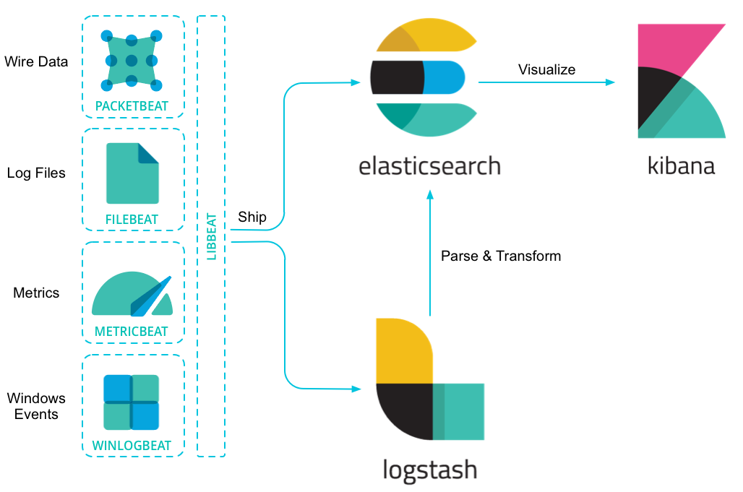
Data flow of Elastic Stack

Slide 9
Elasticsearch

Slide 10
Terms - data
Index
Type
Document
Field
Mapping

Slide 11
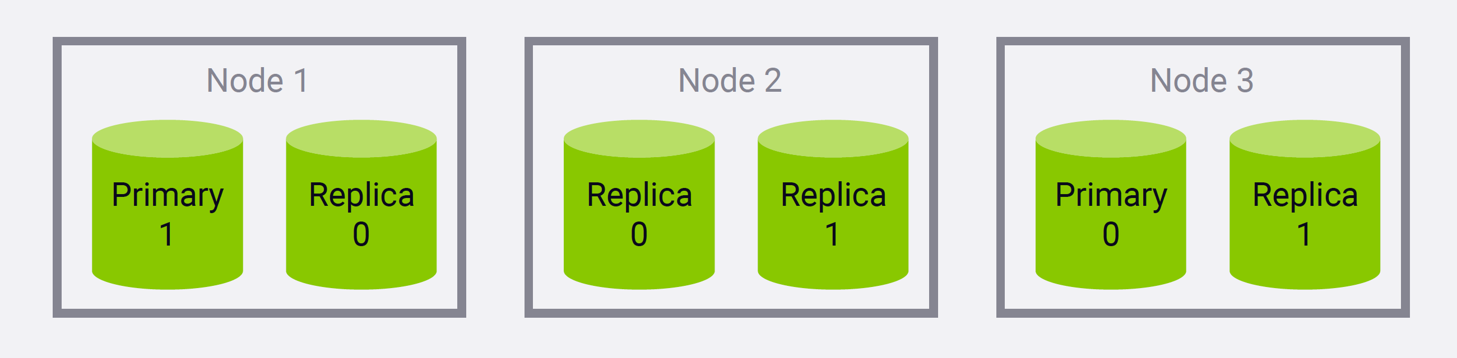
Terms - architecture
Shard (default 5)
Replica (default 1)
Node
Cluster

Slide 12
RESTful API
Elasticsearch provides a handful of RESTful API
CRUD
POST, GET, PUT, DELETE
Basic form (using curl)
curl –H 'Content-Type: application/json' -XGET '127.0.0.1:9200/movies/movie/_search' -d '
{
"query": {
"match": {
"year" : 2014
}
}
}'

Slide 13
Mapping
Define the schema of the documents (type)
Field
Field type
text, keyword, byte, short, integer, long, float, double, boolean, date, binary
https://www.elastic.co/guide/en/elasticsearch/reference/6.2/mapping-types.html
Field analyzer

Slide 14
Create a mapping
curl -XPUT '127.0.0.1:9200/movies?pretty' -d '
{
"mappings": {
"movie": {
"properties" : {
"year" : {"type": "date"}
}
}
}
}'

Slide 15
Get the mapping
curl -XGET '127.0.0.1:9200/movies/movie/_mapping'

Slide 16
Insert a single document
curl -XPUT '127.0.0.1:9200/movies/movie/112556' -d '
{
"genre": ["Drama", "Thriller"],
"title": "Gone Girl",
"year": 2014
}'

Slide 17
Retrieve a single document
curl -XGET '127.0.0.1:9200/movies/movie/112556'
Search the entire index
curl -XGET '127.0.0.1:9200/movies/_search'
Notes:
有一些欄位我們沒有在 mapping 中指定，仍然可以成功加入文件
試一下，如果在 URL 中不指定 ID 會發生什麼事？
方法要換成 POST
As per pure REST conventions, POST is used for creating a new resource and PUTis used for updating an existing resource. Here, the usage of PUT is equivalent to saying I know the ID that I want to assign, so use this ID while indexing this document.
請注意一下沒有指定 ID 與有指定 ID 有什麼不同

Slide 18
Update a document
curl -XPOST '127.0.0.1:9200/movies/movie/112556/_update' -d '
{
"doc": {
"title": "Gone boy"
}
}'
Update a mapping
curl -XPUT '127.0.0.1:9200/movies/_mapping/movie' -d '
{
"properties": {
"rating": {
"type": "float"
}
}
}'
Notes:
field type 一旦指定後就不能更改了

Slide 19
Delete a document
curl -XDELETE '127.0.0.1:9200/movies/movie/112556'
Delete an index
curl -XDELETE '127.0.0.1:9200/movies'
Notes:
請注意一下沒有指定 ID 與有指定 ID 有什麼不同

Slide 20
List all indices
curl -XGET '127.0.0.1:9200/_cat/indices?v'

Slide 21
Insert a bulk of documents
curl -XPUT '127.0.0.1:9200/_bulk' -d '
{ "create" : { "_index" : "movies", "_type" : "movie", "_id" : "135569" } }
{ "id": "135569", "title" : "Star Trek Beyond", "year":2016 , "genre":["Action", "Adventure", "Sci-Fi"] }
{ "create" : { "_index" : "movies", "_type" : "movie", "_id" : "122886" } }
{ "id": "122886", "title" : "Star Wars: Episode VII -The Force Awakens", "year":2015 , "genre":["Action", "Adventure", "Fantasy", "Sci-Fi", "IMAX"] }
{ "create" : { "_index" : "movies", "_type" : "movie", "_id" : "109487" } }
{ "id": "109487", "title" : "Interstellar", "year":2014 , "genre":["Sci-Fi", "IMAX"] }
{ "create" : { "_index" : "movies", "_type" : "movie", "_id" : "58559" } }
{ "id": "58559", "title" : "Dark Knight, The", "year":2008 , "genre":["Action", "Crime", "Drama", "IMAX"] }
{ "create" : { "_index" : "movies", "_type" : "movie", "_id" : "1924" } }
{ "id": "1924", "title" : "Plan 9 from Outer Space", "year":1959 , "genre":["Horror", "Sci-Fi"] }'
Import documents from file
curl -XPUT '127.0.0.1:9200/_bulk' --data-binary @movie.json

Slide 22
Exercise
Import csv file into Elasticsearch using Python scripts
Deal with JSON format directly
Use Python elasticsearch package
Notes:
1. MoviesToJson.py > moremovies.json
IndexRatings.py

Slide 23
Search

Slide 24
Analyzer
Character filter
HTML strip, mapping, pattern replace
Tokenizer
https://www.elastic.co/guide/en/elasticsearch/reference/current/analysis-tokenizers.html
Token filter
Standard, ASCII folding

Slide 25
What does a standard analyzer do?
It provides grammar based tokenization (based on the Unicode Text Segmentation algorithm, as specified in Unicode Standard Annex #29) and works well for most languages.
{ "analyzer": "standard",
"text": "The 2 QUICK Brown-Foxes jumped over the lazy dog's bone." }
[ the, 2, quick, brown, foxes, jumped, over, the, lazy, dog's, bone ]

Slide 26
Search the documents
Query line search
Request body search
curl -XGET '127.0.0.1:9200/movies/_search?q=star'
curl -XGET '127.0.0.1:9200/movies/movie/_search' -d '
{
"query": {
"match": {
"title": "star"
}
}
}'

Slide 27
Query level
Term level - Yes or no?
Range
Exists
missing
Term
Terms
High level - Which is more relevant?
Match
Match phrase
Multi match

Slide 28
Term level query
curl -XGET '127.0.0.1:9200/movies/movie/_search' -d '
{
"query": {
"range": {
"year": {
"gte": 2015,
"lte": 2017
}
}
}
}'

Slide 29
Term level query
curl -XGET '127.0.0.1:9200/movies/movie/_search' -d '
{
"query": {
"term": {
"title": "star"
}
}
}'

Slide 30
High level query
curl -XGET '127.0.0.1:9200/movies/movie/_search' -d '
{
"query": {
"match": {
"title": "star dark"
}
}
}'

Slide 31
High level query
curl -XGET '127.0.0.1:9200/movies/movie/_search' -d '
{
"query": {
"match_phrase": {
"title": "star trek"
}
}
}'

Slide 32
Bool query
curl -XGET '127.0.0.1:9200/movies/movie/_search' -d '
{
"query": {
"bool": {
"must": [...],
"should": [...],
"must_not": {...},
"filter": {...}
}
}
}'

Slide 33
Examples
curl -XGET '127.0.0.1:9200/movies/_search' -d'
{
"query": {
"bool": {
"must": {"match": {"genre": "Sci-Fi"}},
"must_not": {"match": {"title": "trek"}},
"filter": {"range": {"year": {"gte": 2010, "lt": 2015}}}
}
}
}'

Slide 34
Other usage
Slop
Fuzziness
Sorting
Pagination
Partial match (wildcard, prefix)

Slide 35
Aggregations

Slide 36
Types of aggregations
Bucket aggregations
group count, histogram, ranges, etc.
Metric aggregations
sum, average, min, max, etc.
Pipeline aggregations
Matrix aggregations

Slide 37
Bucket aggregations
curl -XGET '127.0.0.1:9200/products/product/_search' -d '
{
"aggs": {
"byCategory": {
"terms": {
"field": "category"
}
}
},
"size": 0
}'

Slide 38
Bucket aggregations
curl -XGET '127.0.0.1:9200/products/product/_search' -d '
{
"aggs": {
"byPrice": {
"histogram": {
"field": "price",
"interval": 100
}
}
},
"size": 0
}'

Slide 39
Bucket aggregations
curl -XGET '127.0.0.1:9200/products/product/_search?size=0' -d '
{
"aggs": {
"byPrice": {
"range": {
"field": "price",
"ranges": [
{ "to": 100 },
{ "from": 100, "to": 1000 },
{ "from": 1000 }
}
}
}
}'
Notes:
包含 from , 不包含 to

Slide 40
Metric aggregations
curl -XGET '127.0.0.1:9200/products/product/_search?size=0' -d '
{
"aggs": {
"revenueSum": {
"sum": {
"field": "revenue"
}
}
}
}'
* replace "sum" with "avg", "min", "max", "stats", "extended_stats", etc.
Notes:
包含 from , 不包含 to

Slide 41
Pipeline aggregations
curl -XGET '127.0.0.1:9200/products/product/_search?size=0' -d '
{
"aggs": {
"byProducer": {
"terms": {
"field": "producer"
}
},
"aggs": {
"avgPrice": {
"avg": {
"filed": "price"
}
}
}
}
}'

Slide 42
Logstash

Slide 43
Logstash
Use a config file to define
Where to collect data (input)
How to process data (filter)
Where to send data (output)
There are various plugins to meet your needs
https://www.elastic.co/guide/en/logstash/current/input-plugins.html
https://www.elastic.co/guide/en/logstash/current/filter-plugins.html
https://www.elastic.co/guide/en/logstash/current/output-plugins.html

Slide 44
Configuration file template
input {
stdin { }
}
filter {
mutate {
uppercase => [ "message" ]
}
}
output {
stdout {
codec => rubydebug
}
}

Slide 45
Input sample - file plugin
input {
file {
path => [
"D:\es\app\*",
"D:\es\logs\*.txt"
]
start_position => "beginning"
exclude => ["*.csv]
discover_interval => "10s"
type => "applogs"
}
}

Slide 46
Output sample - elasticsearch plugin
output {
elasticsearch {
index => "company"
document_type => "employee"
hosts => "localhost:9200"
}
}

Slide 47
Filter sample - grok plugin
filter {
grok {
match => {
"message" => "%{IP:client} %{WORD:method} %{URIPATHPARAM:request} %{NUMBER:bytes} %{NUMBER:duration}"
}
}
}
https://github.com/elastic/logstash/blob/v1.4.2/patterns/grok-patterns

Slide 48
Exercise
Import Apache access log to Elasticsearch
Use Logstash
Use Filebeat

Slide 49
Kibana

Slide 50
How to use Kibana
Create an index pattern
Go Discover to perform a query search
Go Visualize for data visualization
Go Dev Tools to execute RESTful API

Slide 51
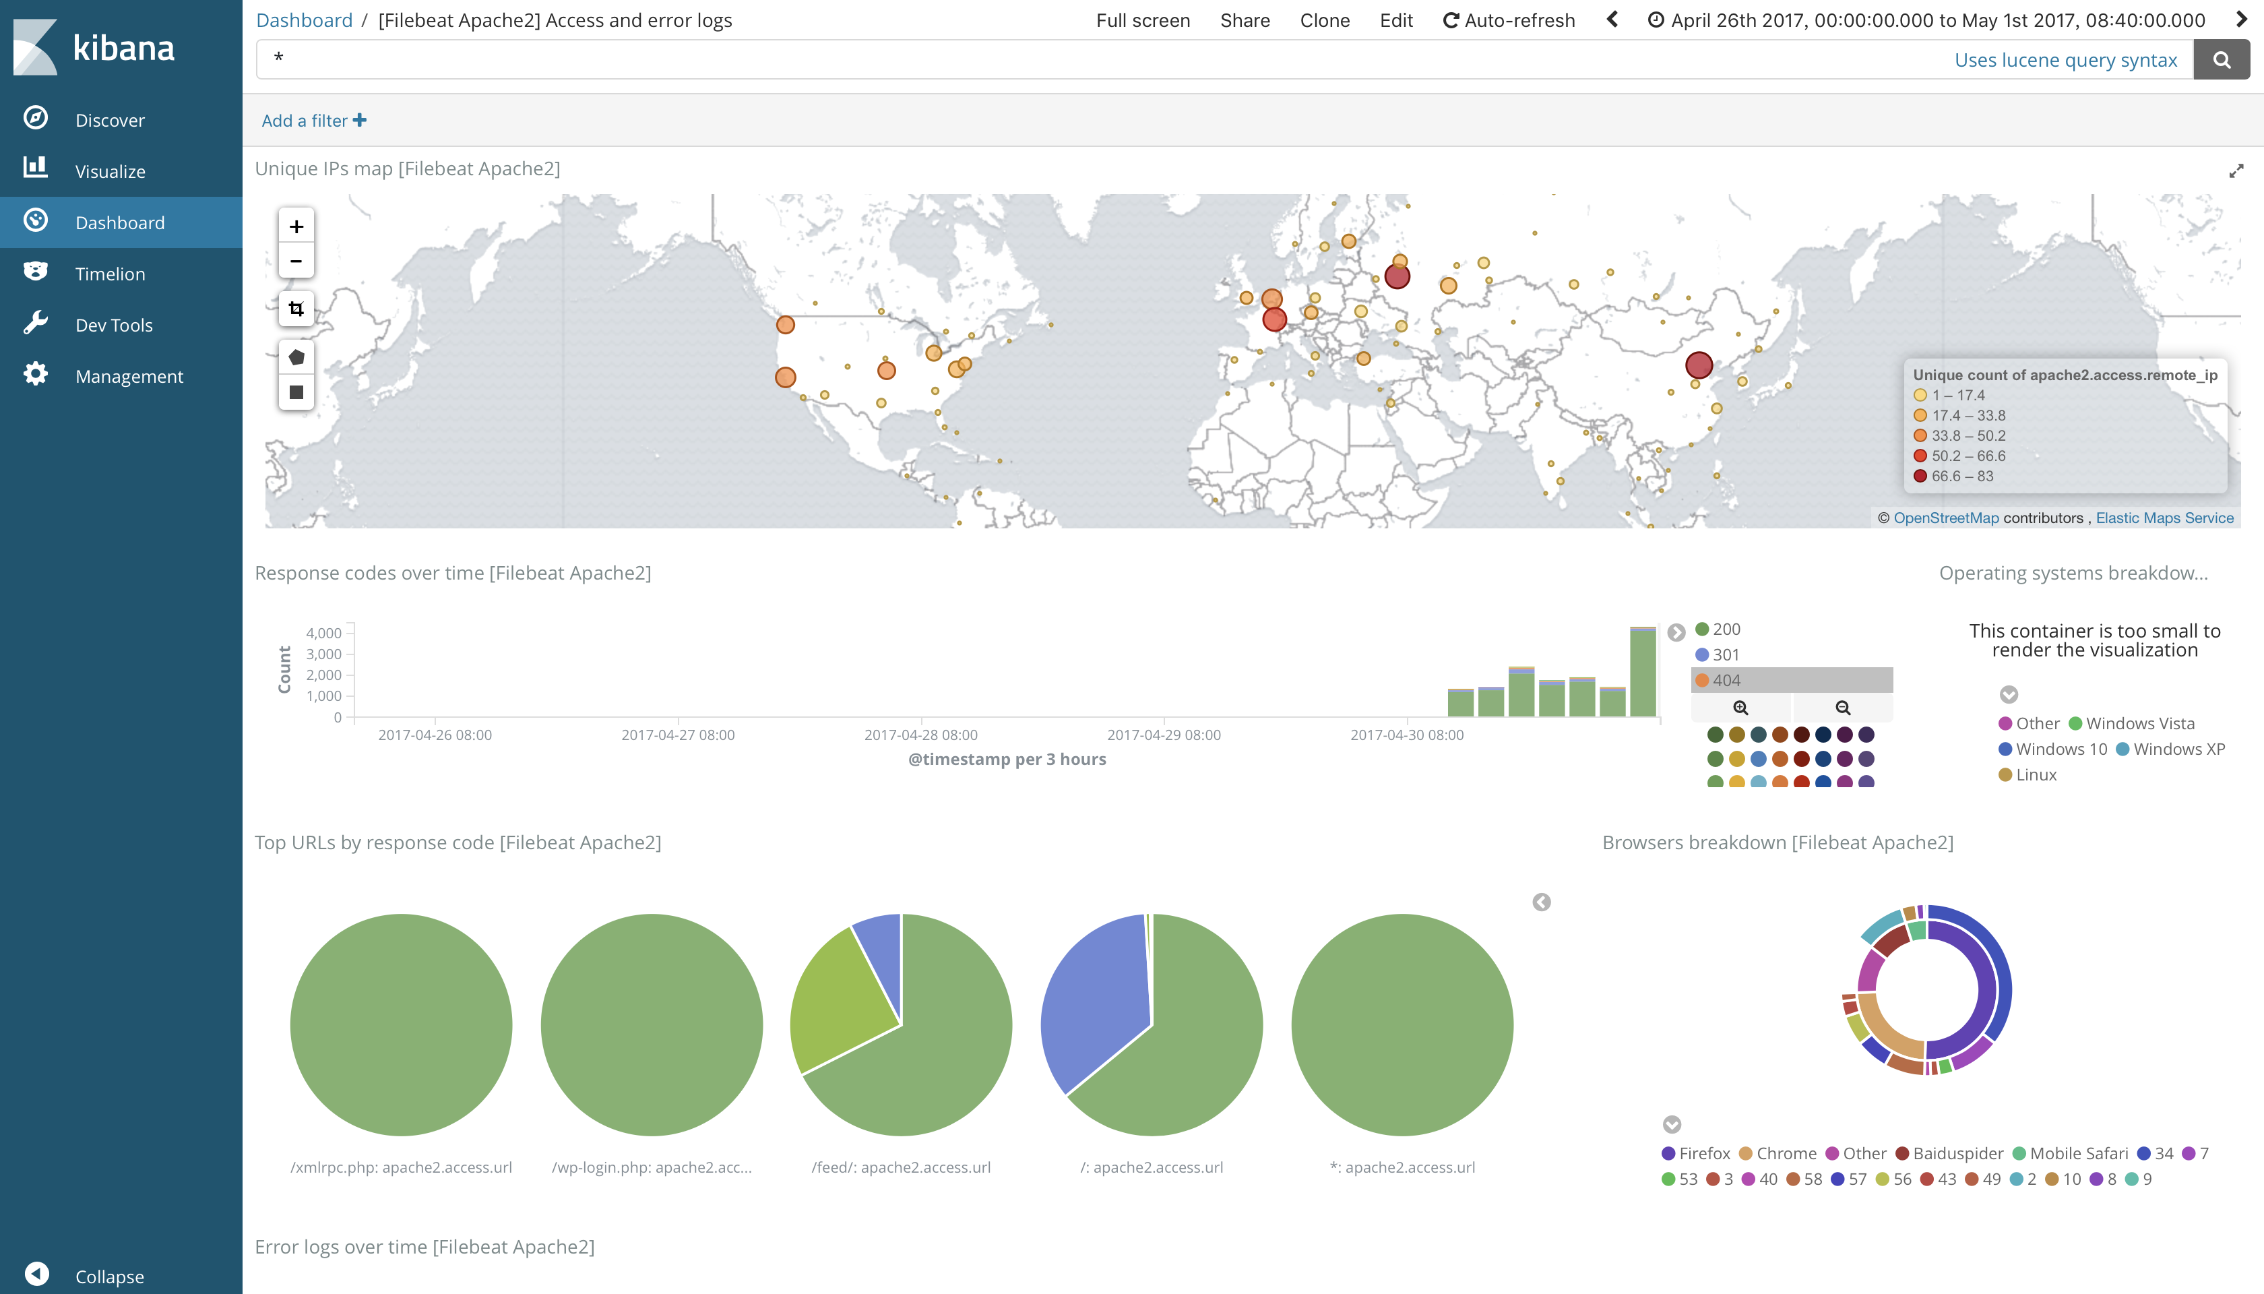

Slide 52
Thank You

Slide 53
Reference
Official Product Website

